Slide 1
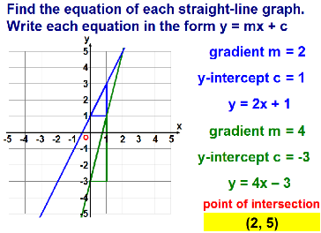
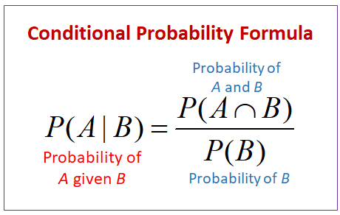
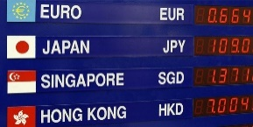
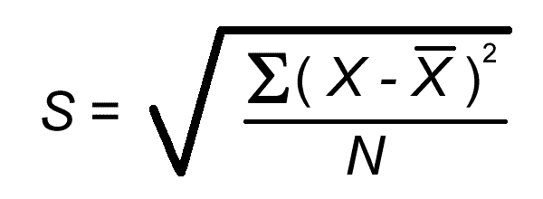
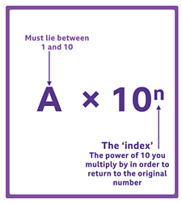
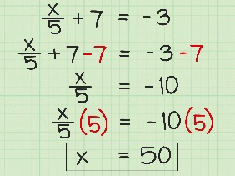
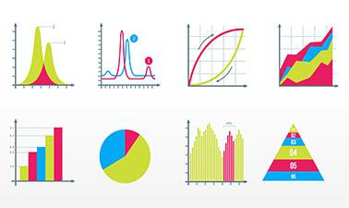
TUXFORD ACADEMY
( ) a a b x= x= x ( ) = b a ab x • apply these laws when solving problems in other contexts, for example simplification of expressions before integrating/differentiating, solving equations or transforming graphs.-way
CORE MATHS LEVEL 3 CERTIFICATE LEARNING JOURNEY
Graphs:
Real life graph analysis
Independent and dependent variables
Inverse and direct proportion
Time series graph
Straight line gradients
Gradients of exponential graphs
OCR H866
(2 hours)
PAPER 1 –Quantitative reasoning (50%) -2 hrs
PAPER 2 – Critical Maths (50%)- 2 hrs
Estimations:
Modelling approach to solve large scale problems
Using real life estimations such as populations, body measurements, capacity of public transport
Estimations using units – length, area and volume
Exponentials:
Explore exponential growth and decay and draw graphs
Apply to real life situations
Solving exponential equations
Interpret a log scale graph
Read off x and y values
Displacement and Velocity:
Calculate using speed, distance and time
Convert units for SDT
Understand the difference between displacement and velocity
Interpret their graphs
Financial Maths:
APR/VAT/inflation
Loans (student and payday)
Payslips
Mortgages
Supply and demand curves
Costings in business
Financial vocabulary
Scams:
Find sources of bias
Expected number is average number
Probability:
Two way tables and estimating
Independent and dependent events
Tree diagrams (unconditional and conditional)
Conditional probability, A given B does not equal B given A.
Real life problems including medical trials.
Risk- probability in the form 1:n
Interpreting a risk assessment
Working out expectation of an event over time
Prosecutors and dependants fallacy
Normal Distribution:
Understand normal distribution and relate to standard deviation
Solve problems using percentage distributions
Calculate z-scores
Normal probability plots
Controlled trials:
Randomised controlled trials
Blind and double blind testing
Fallacies:
Prosecutor/defendant
Gambler’s fallacy
Risk:
Write risk as one in n years
Put risks in order of likelihood
Spreadsheets:
Read information
Enter and interpret formulas
Draw graphs
Foreign Exchange:
Use foreign currency exchange calculation or estimate, with or without commission
Understand foreign currency exchange information in the form “We sell at 1.54, we buy at 1.69”
Percentages:
Increase/decrease with multipliers
Reverse percentages
Real life problems
Compound interest/growth/decay
Find compound multipliers or borrowing periods using trial and error or using logs
Measures and Scaling:
Convert between units of length, area and volume in a real life context
Apply regulations to real life
Understand plans, elevations and sketches
Solve real life ratio problems
Interpret scale drawings
Standard Deviation:
Calculate the averages including the weighted mean
Understand standard deviation and calculate with a calculator
Estimate standard deviation
Apply to real life problems
Bounds:
Real life application
Interpret and draw diagrams
Use bounds in percentages
Teacher B
CORE MATHS
Teacher A
LEVEL 3 CERTICATE
Algebra:
Represent real life situations algebraically
Form and solve equations
Rearrange equations
Substitution including effective use of a calculator
Statistics:
Types of data
Sampling methods
Bar charts
Pie charts
Scatter graphs and correlation
Regression to the mean
Box plots and cumulative frequency
Histograms
Interpret and analyse all the above
Averages
Weighted Mean
Standard Form:
Converting
Use a calculator to solve real life standard form questions

