Slide 1
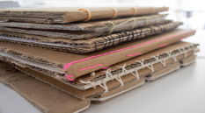
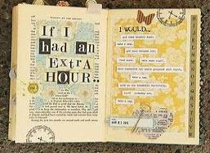
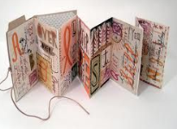
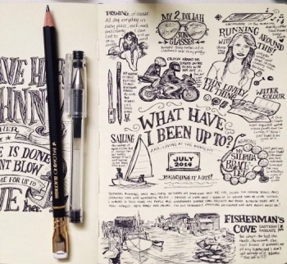
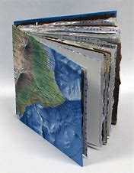
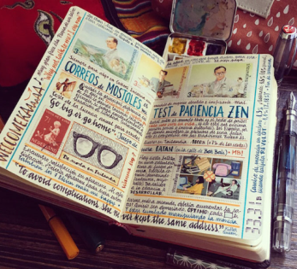
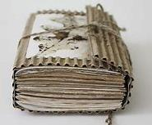
What? Create a visual art journal which reflects aspects of your own life in lock down and personality in a small A5 sketchbook or altered book.
How? Use a combination of drawings, paintings and text/words to illustrate the suggested themes using a range of materials, techniques and processes.
Why? To develop and refine your observation drawing skills by looking more closely at things around you that you see every day, and to explore skills in creating drawings from imagination.
Y12 A level Art
Journal Transition Project
2020
Sketchbook and Journal ideas
Task 1: Create a sketchbook, try to use one that is no bigger than A5 in size. You can buy an A5 sketchbook and adapt, but it’s also just as easy to make your own - look at some of these examples for ideas. Just use whatever you have available at home. Check out the links and look on YouTube for ideas linked to handmade artist sketchbooks.
You can use an old, damaged or unwanted paper or hardback book and draw on top of the pages and words
Create an accordion or concertina journal by folding and gluing paper into a long strip.
https://www.accessart.org.uk/sketchbooks-an-online-course-for-children-families-parents-teachers/?fbclid=IwAR0eXgOhXUnmJdtsLP-0-SaSrYINphDO0pQP2KlcHuOGrEHLQMQpDJc2IYk
Cardboard cover folded in half with a range of papers inside. Bound together by wrapping some string or an elastic band around the middle.

Slide 2
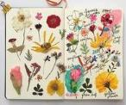
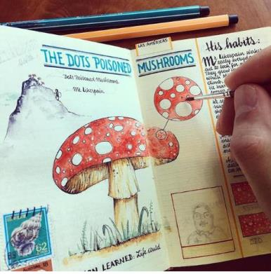
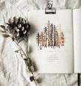
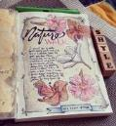
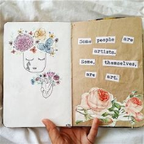
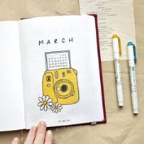
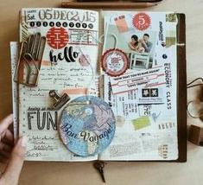
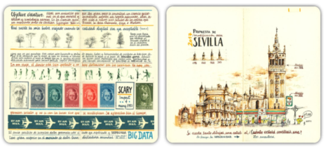
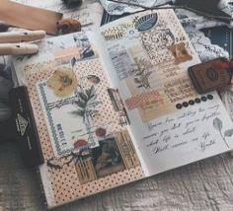
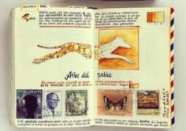
What will I draw?
You can also collage things into your journal and draw on top of them
Page inspiration and layout ideas
Each double page will have
a task which should take you
up to at least the Summer term.
You can draw from direct observation, use your own photos or find images on the internet as inspiration. Look at the slides below with artists who use sketchbooks and journals. You can add more pages and continue it over the Summer too, ready to bring back in September.
You can use small titles or dates using a relevant font as a way to give context to your page
Use annotation to write notes or add further information about the things you have drawn
Use more than one media or technique per double page. Try using different techniques, such as cross hatching, continuous line, detailed tonal studies etc
Think carefully about layout and composition. Some pages can be filled with images and others can have lots of empty space.
Use a range of different size drawings on the page and add small images and boxes
Receipts
Tickets
Wrappers
Scrap paper
Envelopes
Postcards
Flyers
Newspapers
Think about literacy when you annotate your pages, and use these to create a flow and visual story which travels across different pages.

Slide 3
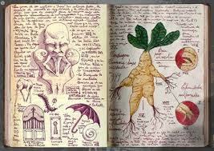
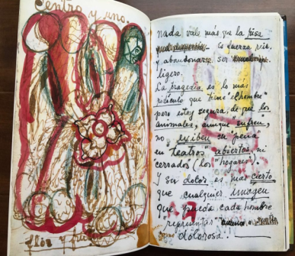
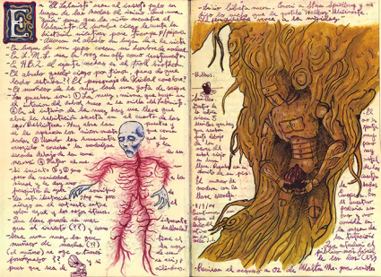
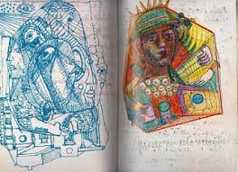
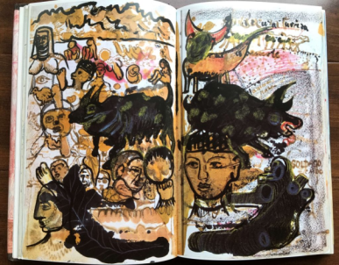
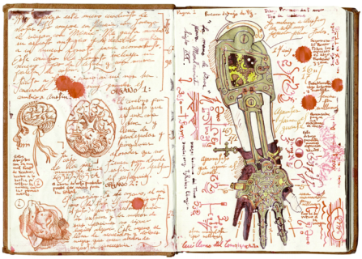
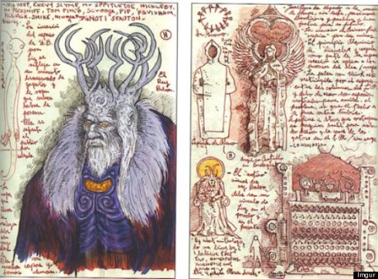
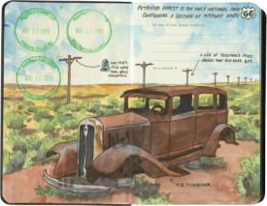
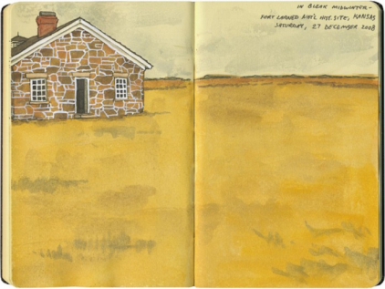
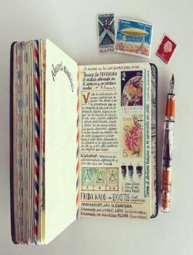
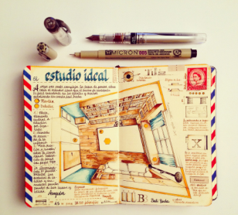
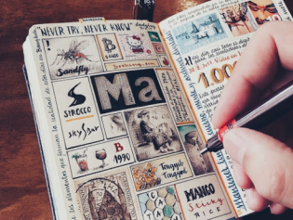
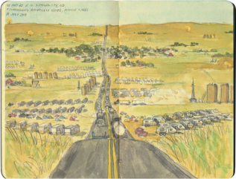
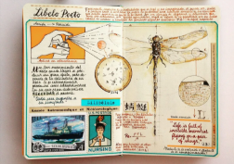
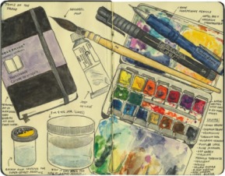
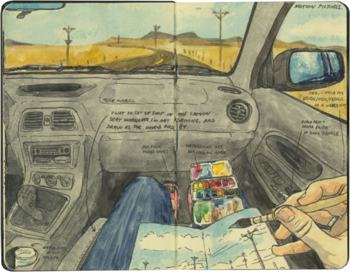
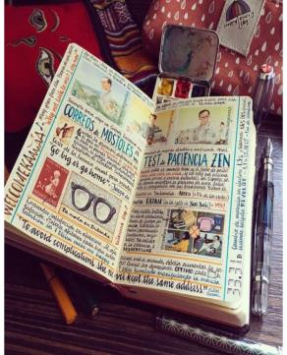
Guillermo Del Toro
Frida Kahlo
Here are some artists and designers’ sketchbooks for inspiration.
Jose Naranja
https://www.thisiscolossal.com/2018/04/handmade-sketchbooks-by-jose-naranja/
Chandler O’Leary
http://josenaranja.blogspot.com/

Slide 4
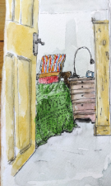
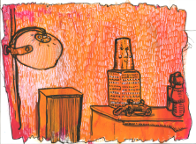
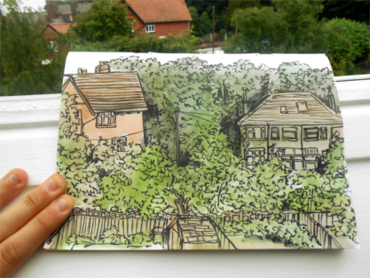
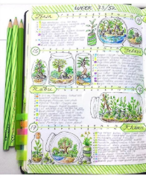
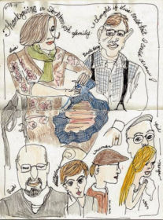
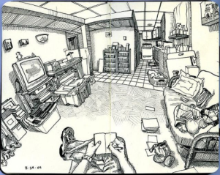
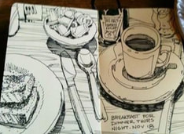
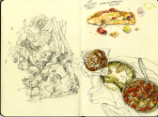
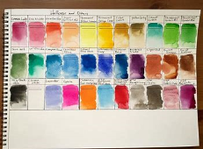
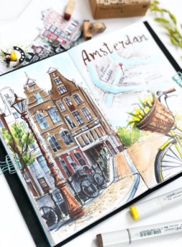
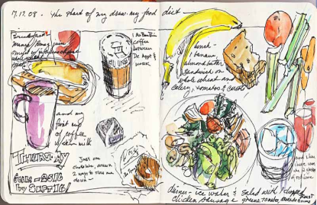
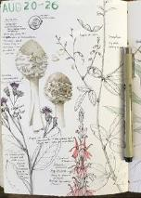
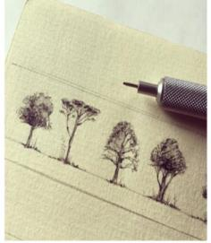
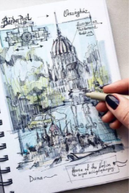
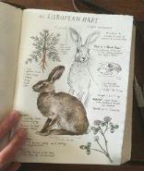
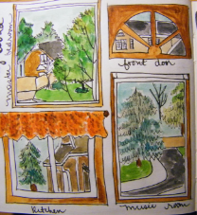
Tasks & Themes to do on each page:
Page 11: Family
(roles, members)
Page 12: Favourite artist
(critical analysis of their work)
Page 13: Colour
(colour wheel and colour theory)
Page 14: Nature
(Flowers, garden plants, weather)
Page 15: Watch a document
(What did you learn? How did it inspire you?)
Page 1: Inside
(favourite room/ parts of your house?)
Page 2: Outside
(your view outside/ parts of the garden)
Page 3: Places i.e (past holidays/ internet)
Page 4: Food
(log of what you eat/ content of your fridge)
Page 5: Review on an art gallery online.
https://www.youtube.com/watch?v=nG3MIXkRMS0&list=PL5uUen04IQNkFECI0L3r-7zGY9RBgIKw8
https://www.theguardian.com/travel/2020/mar/23/10-of-the-worlds-best-virtual-museum-and-art-gallery-tours
https://www.tate.org.uk/visit/tate-britain/display/walk-through-british-art
Page 16: Animals
(animals that you see on a walk, favourite animals, pets)
Page 17: Favourite Film (watch and record what you see, hear, phrases)
Page 18: Patterns & textures (Mark making, close ups)
Page 19: Sensory (sit in a place and record what you hear, see, smell, feel, taste?)
Page 20: Evaluation
(WWW, EBI, how did the journal go?)
Page 6: Windows
(rainbow signs/ different types in your house)
Page 7: Trees
(Go on a walk and photograph to draw)
Page 8: Water
(sea, tap, bath, drink)
Page 9: Possessions
(order them, own, family members)
Page 10: Childhood
(Photographs, holidays, toys)

